Slide 1
SQL – Aggregations
Aggregation: Takes values in multiple rows of data and returns one value
    SUM(FIELD_NAME)
    AVG(FIELD_NAME)
    MIN(FIELD_NAME)
    MAX(FIELD_NAME)
    COUNT(FIELD_NAME) or COUNT(*)
SUM and AVG require that the field be numeric
MIN and MAX will work with a variety of data types
NULL: Represents the absence of data
Not the same as a zero (numeric value) a space (text value)
All aggregate functions except COUNT ignore NULL values
    COUNT(FIELD_NAME) and COUNT(*) give different values if NULLs present

Slide 2
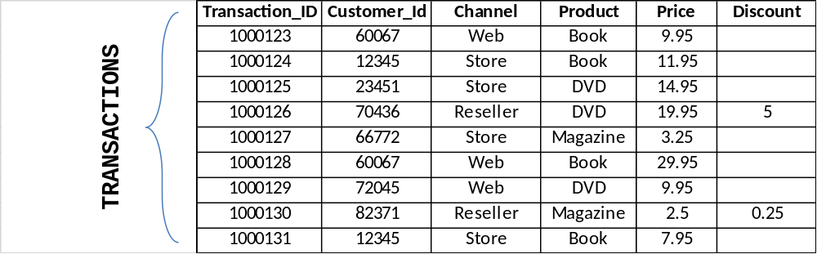
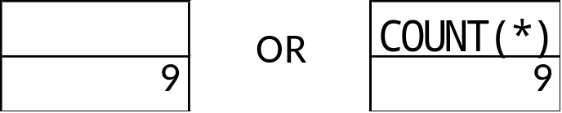
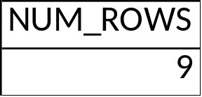
SQL – Whole Table Aggregations
SELECT COUNT(*)
FROM TRANSACTIONS
SELECT COUNT(*) AS NUM_ROWS
FROM TRANSACTIONS
NUM_ROWS is the ‘Alias’ for COUNT(*) and is designated using ‘AS’

Slide 3
SQL – The GROUP BY Clause
GROUP BY | Defines the level of aggregation I want if I’m summarizing data
SELECT GROUP_FIELD_1, ..., GROUP_FIELD_N,
<AGGREGATE_1>, ..., <AGGREGATE_2>
FROM TABLE_NAME
GROUP BY GROUP_FIELD_1, ..., GROUP_FIELD_N
GROUP_FIELD(s) must match in SELECT and GROUP BY clauses
Everything else in the SELECT statement must be an aggregate function, e.g.:
SUM(FIELD_NAME)
AVG(FIELD_NAME)
MIN(FIELD_NAME)
MAX(FIELD_NAME)
COUNT(FIELD_NAME) or COUNT(*)

Slide 4
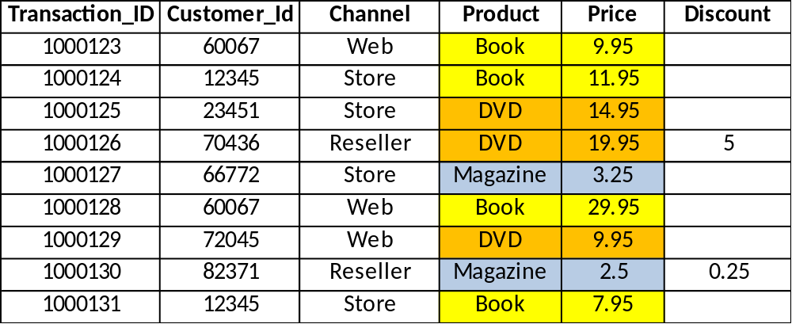
SQL – The GROUP BY Clause
Let’s say I want to know the following by Product:
Total number of purchases by product
Total dollar value of purchases by product
Average dollar value of purchases by product
# Purchases = # Rows = COUNT(*)
SUM(Price)
AVG(Price)

Slide 5
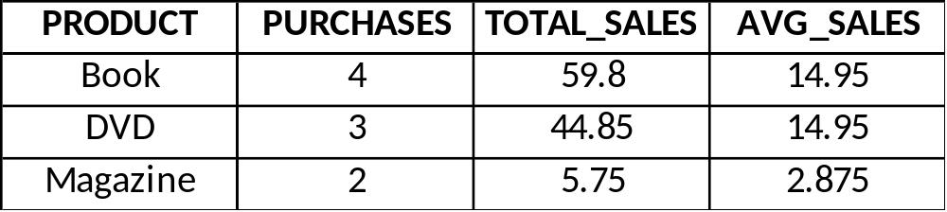
SQL – The GROUP BY Clause
SELECT PRODUCT, COUNT(*) AS PURCHASES,
SUM(PRICE) AS TOTAL_SALES,
AVG(PRICE) AS AVG_SALES
FROM TRANSACTIONS
GROUP BY PRODUCT

Slide 6
SQL – The HAVING Clause
HAVING | Adds filters that restrict what aggregated rows / records are retrieved
SELECT GROUP_FIELD_1, ..., GROUP_FIELD_N,
<AGGREGATE_1>, ..., <AGGREGATE_2>
FROM TABLE_NAME
GROUP BY GROUP_FIELD_1, ..., GROUP_FIELD_N
HAVING <logical conditions(s)>
In this case conditions must be applied to one or more of the aggregate functions defined in the SELECT statement.

Slide 7
SQL – The HAVING Clause
Let’s start with the results from the GROUP BY example:
SELECT PRODUCT, COUNT(*) AS PURCHASES,
SUM(PRICE) AS TOTAL_SALES,
AVG(PRICE) AS AVG_SALES
FROM TRANSACTIONS
GROUP BY PRODUCT
Now suppose that I only wanted to see products with average sales over $10

Slide 8
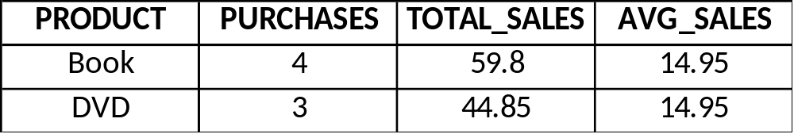
SQL – The HAVING Clause
SELECT PRODUCT, COUNT(*) AS PURCHASES,
SUM(PRICE) AS TOTAL_SALES,
AVG(PRICE) AD AVG_SALES
FROM TRANSACTIONS
GROUP BY PRODUCT
HAVING AVG_SALES > 10

Slide 9
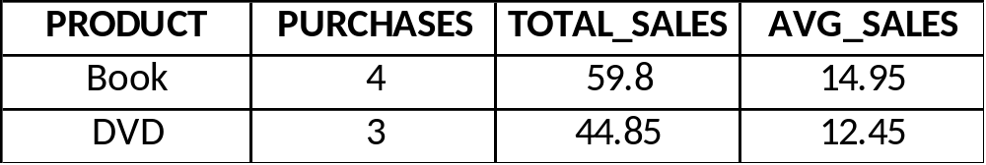
SQL – The HAVING Clause
SELECT PRODUCT, COUNT(*) AS PURCHASES,
SUM(PRICE) AS TOTAL_SALES,
AVG(PRICE) AD AVG_SALES
FROM TRANSACTIONS
WHERE CHANNEL <> 'RESELLER'
GROUP BY PRODUCT
HAVING AVG_SALES > 10

Slide 10
SQL – The ORDER BY Clause
ORDER BY | Defines the sort order of the results
SELECT FIELD_1, FIELD_2, ..., FIELD_N
FROM TABLE_NAME
ORDER BY FIELD_i, ...., FIELD_n
By default, sorts in ascending order, but descending can be specified as follows:
ORDER BY FIELD_i DESC
Sorting field(s) can be anything in the source table, whether or not it’s in the SELECT statement

Slide 11
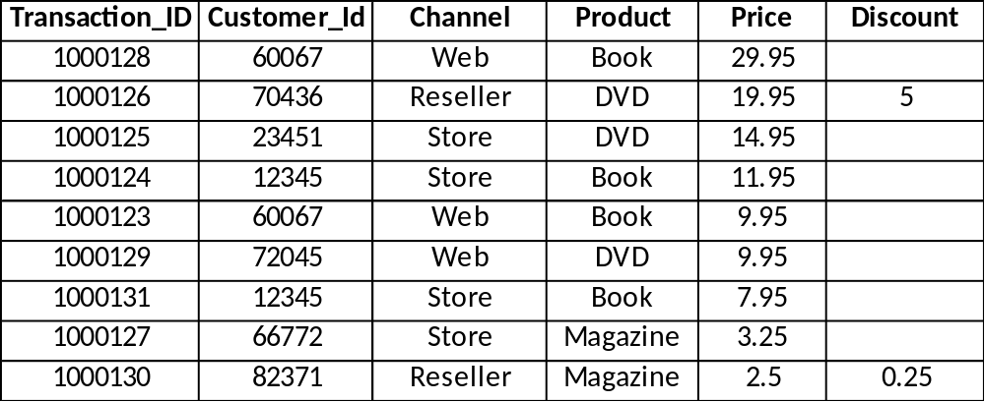
SQL – The ORDER BY Clause
SELECT *
FROM TRANSACTIONS
ORDER BY PRICE DESC

